Slide 1
Is a tidal wave of inflation looming?
Erik Sandstrom

Slide 2
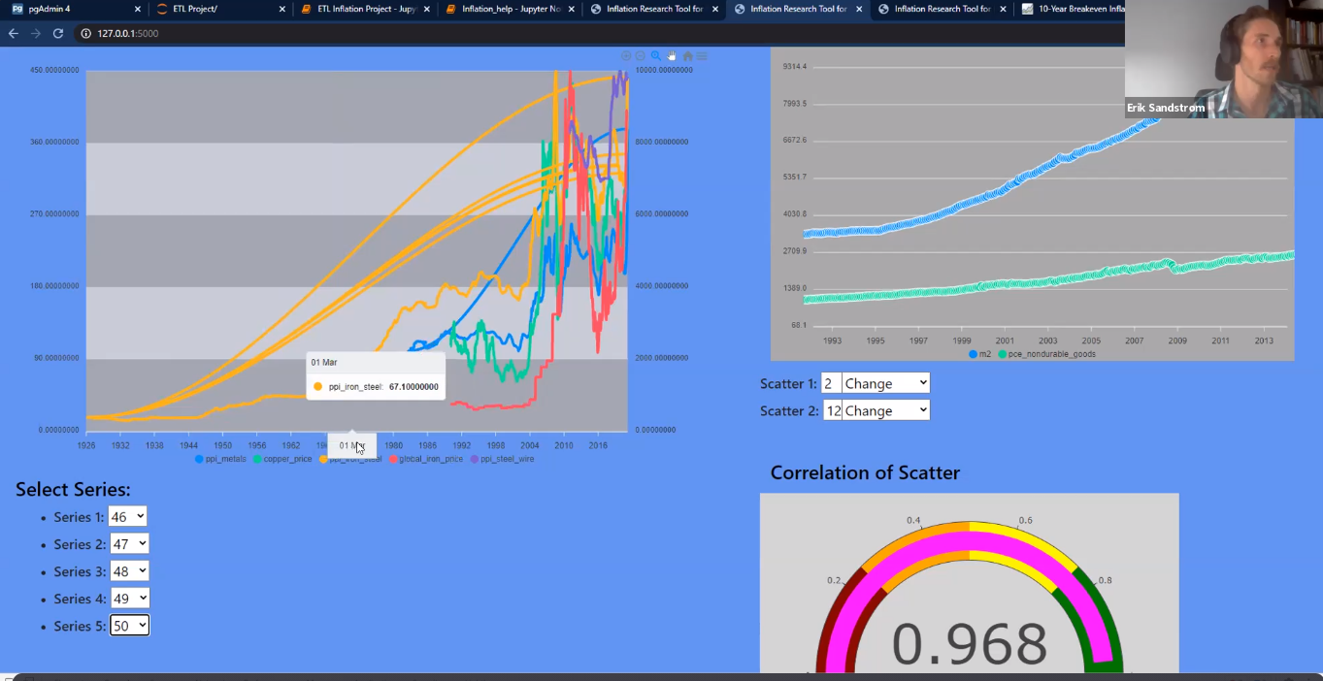
Project 2 was… ok

Slide 3
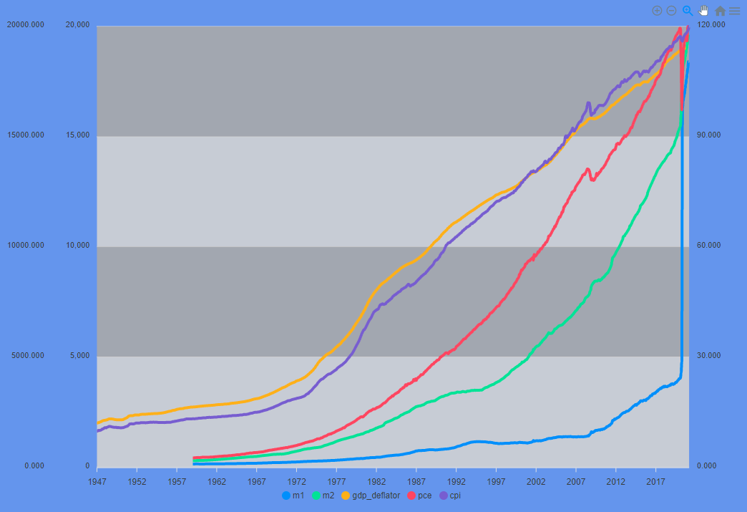
What is Inflation?
CPI
PCE
GDP Deflator

Slide 4
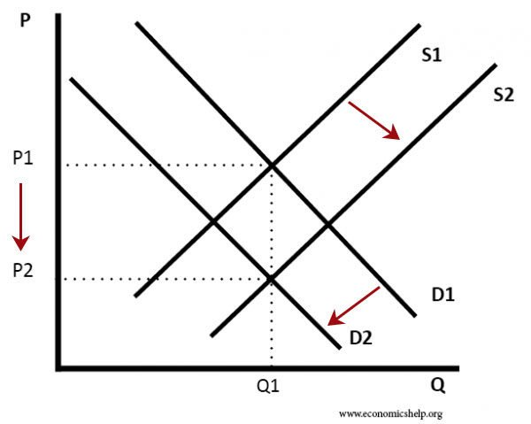
Prices can increase without inflation

Slide 5
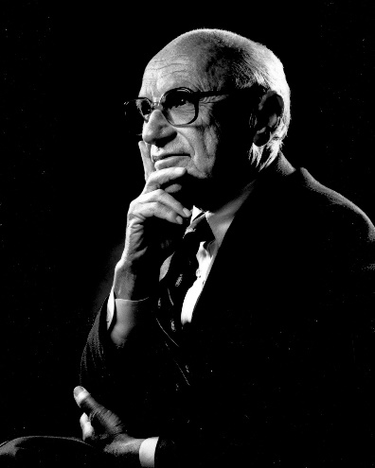

Milton Friedman vs. MMT… and everything in between
“Inflation is always and everywhere a monetary phenomenon in the sense that it can be produced only by a more rapid increase in the quantity of money than in output” - Milton Friedman
“Once you’re able to see that the government’s ability to spend doesn’t revolve around the taxpayer dollar, the whole fiscal paradigm shifts” – Stephanie Kelton

Slide 6
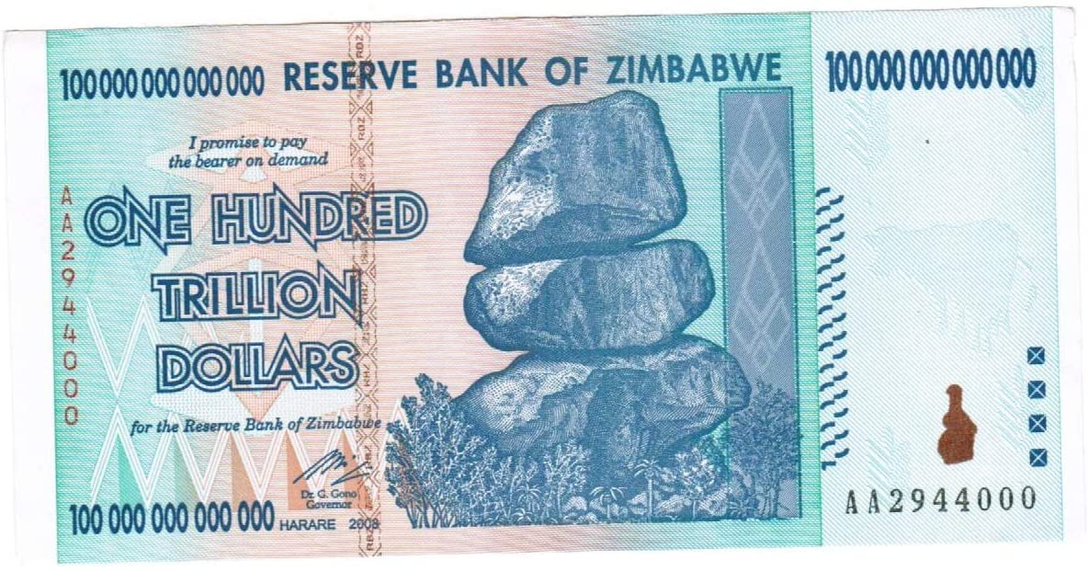
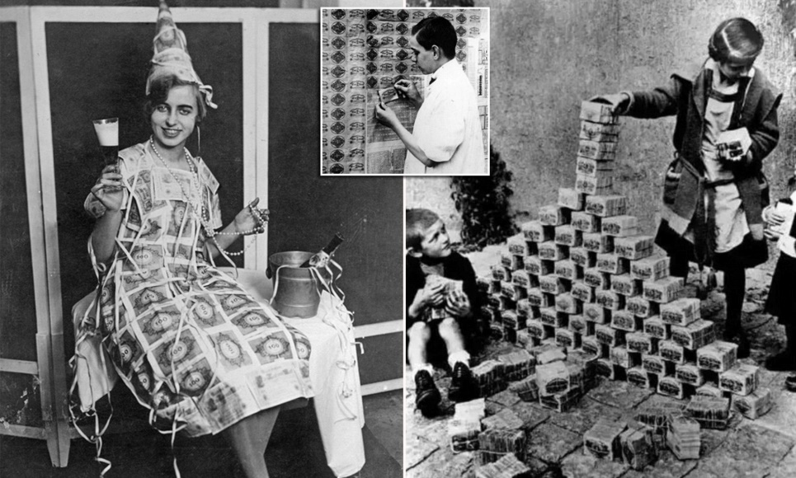
Money printing
The Dollar became a fiat currency in 1971

Slide 7
Quantity theory of Money
MV = PY
M = Monetary Base (Currency + Reserves)
V = Velocity of Money
P = Price Level
Y = Gross Domestic Product/Income/Output

Slide 8
Hypotheses
Inflation has stayed reasonable because...
We have exported inflation
Technology improvements have increased our productivity, lowering the cost of goods
Banks are hoarding cash, so it's not out in the broader economy influencing prices

